Slide 1
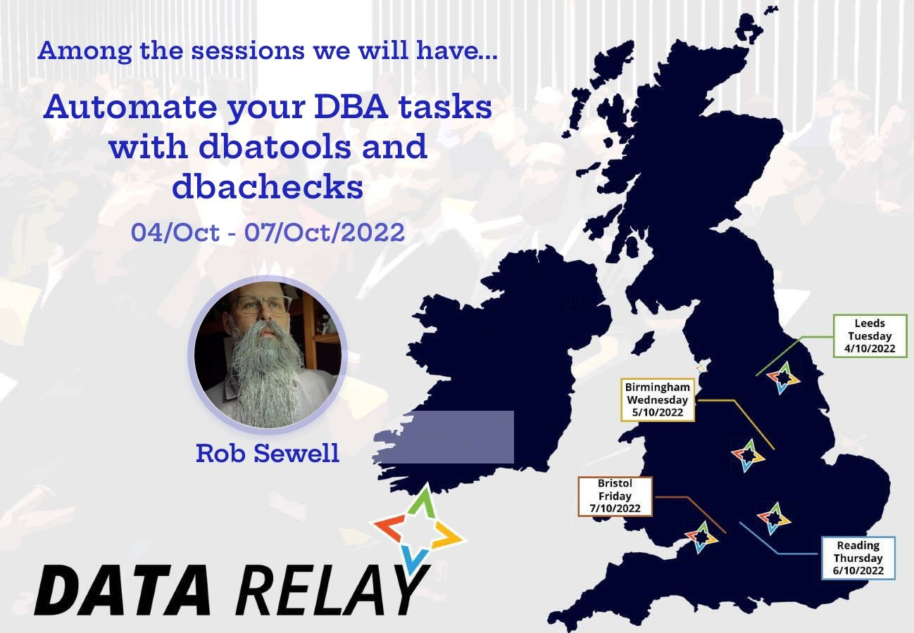

PowerShell With Excel

Slide 2






Rob Sewell
He/Him
Bearded Consultant
Automator
Trainer
Consultant Sewells Consulting Ltd
beard.media/book dbachecks PowerShell & Data Community
/robsewellsqldba
@sqldbawithbeard
blog.robsewell.com

Slide 3









Sponsors
Thank you!
We couldn’t do it without you.

Slide 4

Register Now events.sqlbits.com/2023
Register Now events.sqlbits.com/2023
Submit Sessions
sessionize.com/sqlbits-2023 sessionize.com/sqlbits-trainingdays2023
Volunteer beard.media/sqlbits-helpers

Slide 5
Ask me questions anytime
Slides are always here - https://beard.media/presentations Notebooks are here - https://beard.media/Notebooks @SQLDbaWithBeard – Is where to find me later blog.robsewell.com – Is where to read things!
Notes:
OBS:Full Screen

Slide 6
Pop Quiz
In organisations – where is most data used ?
Notes:
OBS:Full Screen

Slide 7
Pop Quiz
Where is it most requested to be displayed?
Notes:
OBS:Full Screen

Slide 8

Notes:
OBS:Full Screen

Slide 9
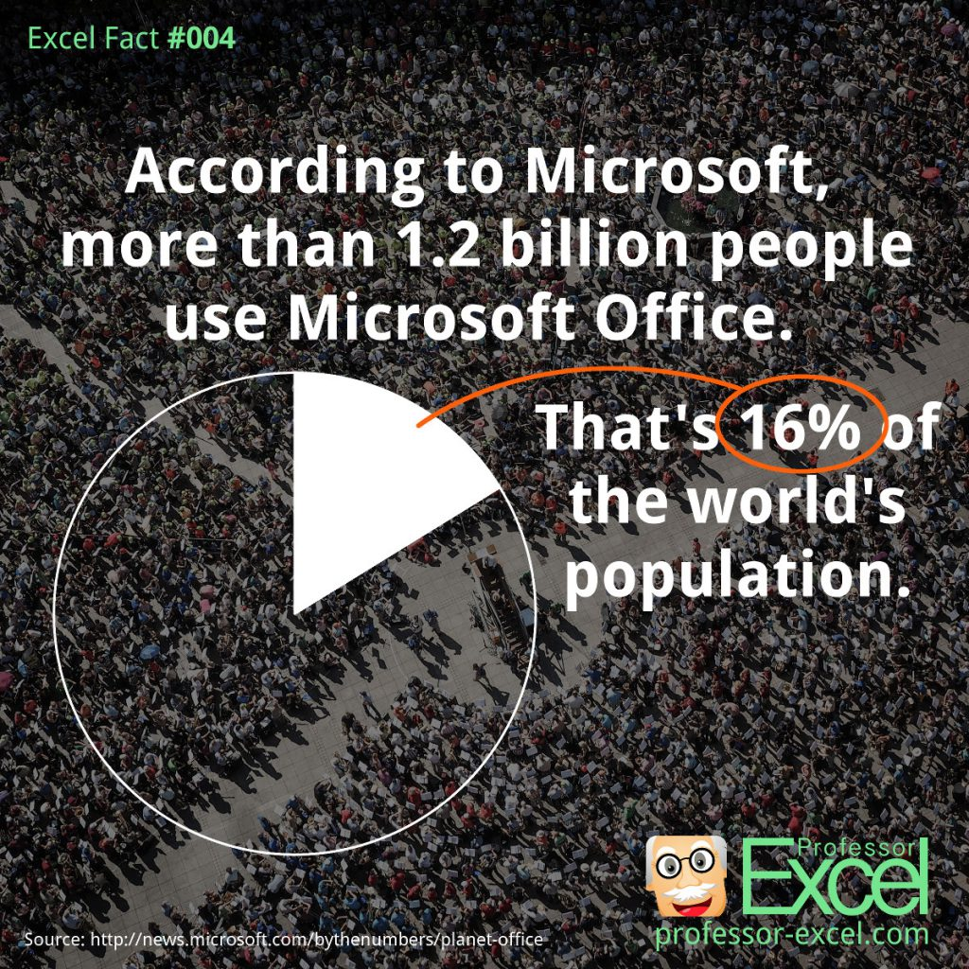
Notes:
OBS:SpeakerRightHalf

Slide 10

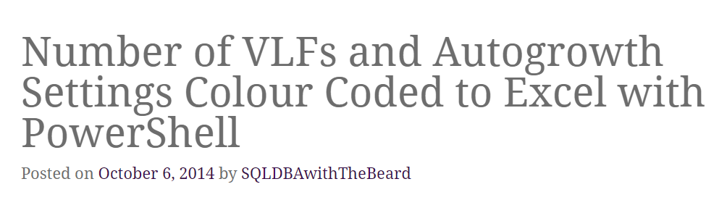
Notes:
OBS:SpeakerCentreBottom

Slide 11
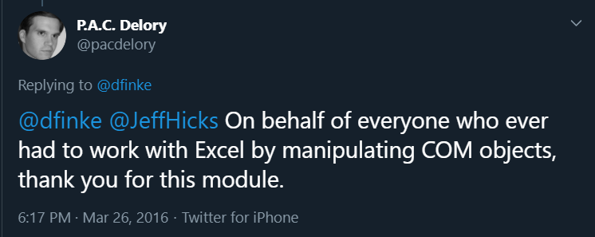
Notes:
OBS:SpeakerCentreBottom

Slide 12

https://beard.media/notebooksyoutube Various Beardy Demos about Jupyter Notebooks in Azure Data Studio. Many demos are different even if the presentation is the same.
Time For A DEMO

